Slide 1

Power BI Finance Dashboard
This presentation provides an overview of a Power BI finance dashboard, covering key aspects such as data understanding, sales analysis, discount strategies, shipping costs, and product base margin evaluation. The dashboard aims to provide actionable insights for financial decision-making.
by Ayonika Dutta

Slide 2
Introduction of Finance Dashboard
This finance dashboard created using power by desktop design to provide an integrated view of financial performance across various dimensions it compiles essential dimensions such as sales, discounts, shipping cost and product with margin presenting them in an intuitive visually engaging format the dashboard breaks down the financial data by region City month and product category and applying a analysis of special and temporal trends it offers details insights into how different segment from overall sales to specific product lines perform within distinct markets nearby supporting data driven decision making the reports design emphasizes clarity and each of navigation along users to quickly access key performance indicators and understand the underlying factors affecting profitability. Overall, the dashboard serves as a powerful analytical tool that not only summarizes data but also facilitates strategic planning and operational efficiency in a dynamic business environment.

Slide 3
Understanding & Cleaning the Data
Understanding the Data:
The Finance Dashboard, Power BI desktop compiles key financial metrics from a comprehensive dataset. It displays aggregated figures like a Sales amount of $2.64M, Discounts of $95.55K, Shipping Cost of $25.52K, and a Product Base Margin of $996.91K. The data is segmented by regions, cities, product categories and months allowing for a detailed analysis of business performance across various dimensions. Visualizations such as regional profit breakdowns, monthly sales trends and discount distribution help pinpoint strengths and areas for improvement.
Cleaning the Data:
After understanding the data, the raw data likely underwent rigorous cleaning to ensure accuracy. This process would have involved standardizing formats (e.g., dates and currencies), removing duplicate records, and addressing missing and inconsistent values. outlier detection methods may have been applied to identify and correct anomalous entries, ensuring that the aggregated figures reflect true performance. Such preprocessing is essential for creating reliable dashboards that deliver actionable insigts for strategic decision making.

Slide 4
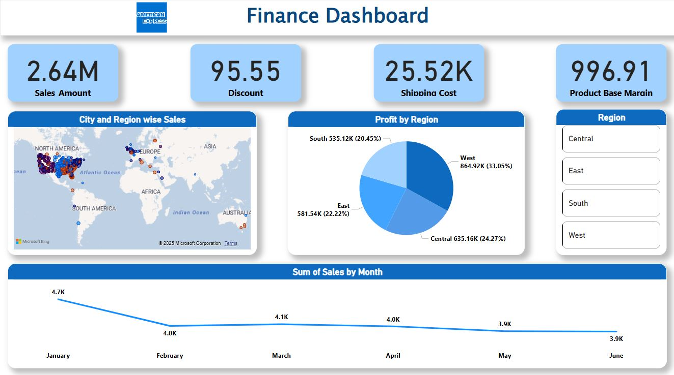
Finance Dashboard
This finance dashboard provides a comprehensive overview of key financial metrics using various visualizations.
Sum of Sales by Month: A line chart illustrates sales trends over six months, showing a decline from 4.7K in January to 3.9K in June, indicating a downward sales trend.
Profit by Region: A pie chart presents regional profit distribution, with the West leading at 33.05%, followed by Central (24.27%), East (22.22%), and South (20.45%).
City and Region-wise Sales: A geographic map highlights strong sales activity in North America and Europe.
Key Financial Metrics: Total sales amount is 2.64M, shipping cost is 25.52K, and product base margin is 996.91, providing insights into overall profitability.

Slide 5
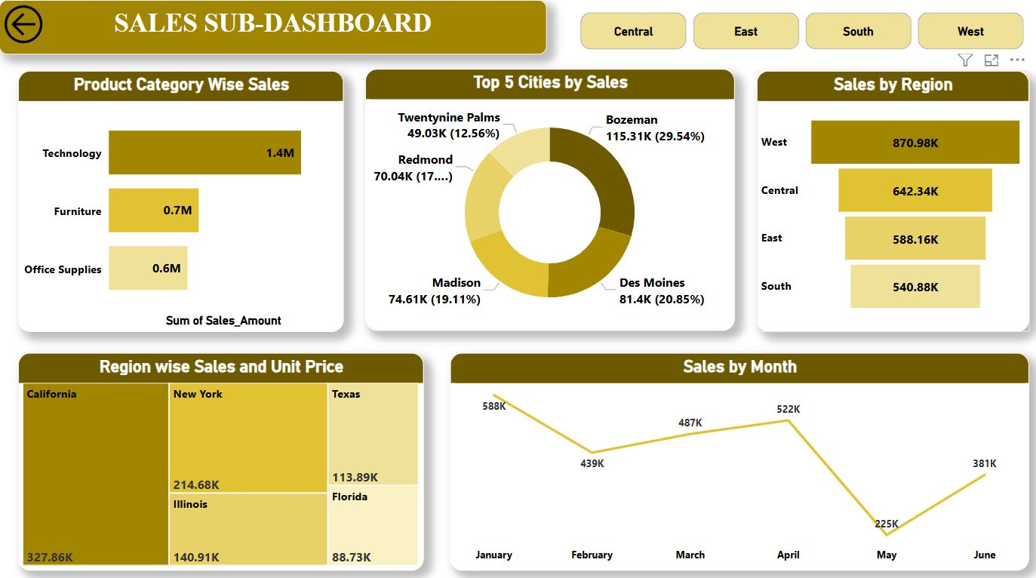
SALES SUB-DASHBOARD
This sales sub-dashboard provides a comprehensive overview of key sales performance metrics using various visualizations.
Sales by Month: A line chart displays sales trends over six months, showing fluctuations with a peak in April (522K) and a drop in May (225K), followed by a recovery in June (381K).
Sales by Region: The West leads with 870.98K, followed by Central (642.34K), East (588.16K), and South (540.88K), indicating regional variations in sales performance.
Product Category Wise Sales: Technology (1.4M) dominates, followed by Furniture (0.7M) and Office Supplies (0.6M), suggesting a higher demand for tech products.
Top 5 Cities by Sales: Bozeman (115.31K, 29.54%) leads, followed by Des Moines (81.4K, 20.85%) and Madison (74.61K, 19.11%), highlighting key revenue-generating cities.
Region-wise Sales and Unit Price: California leads with 327.86K, followed by New York (214.68K), Texas (113.89K), and Illinois (140.91K), emphasizing state-wise sales performance.

Slide 6
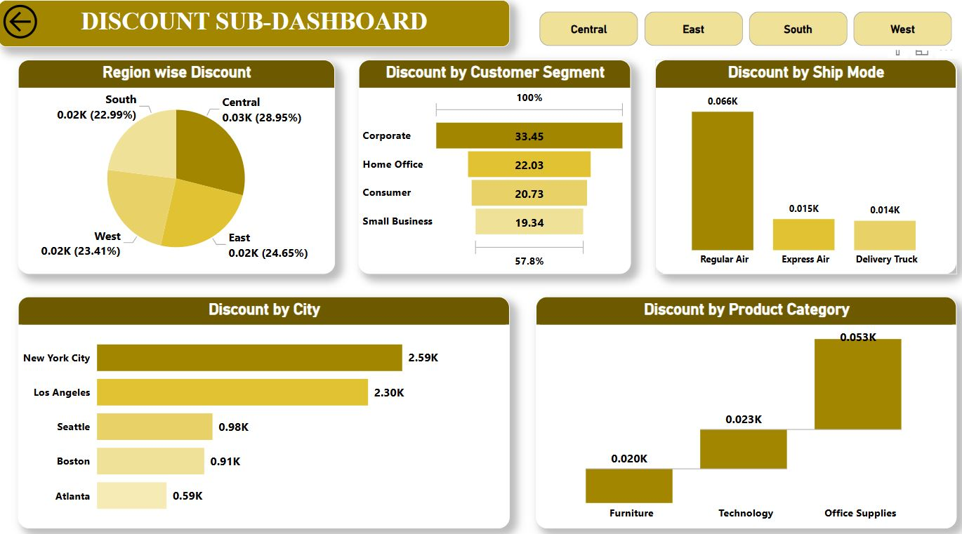
DISCOUNT SUB-DASHBOARD
This Discount Sub-Dashboard provides a comprehensive overview of key discount metrics using various visualizations.
Region-wise Discount: The Central region has the highest discount (28.95%), followed by East (24.65%), West (23.41%), and South (22.99.
Discount by Customer Segment: The Corporate segment receives the highest discount (33.45%), followed by Home Office (22.03%), Consumer (20.73%), and Small Business (19.34%).
Discount by Ship Mode: Regular Air (0.066K) receives the highest discounts compared to Express Air (0.015K) and Delivery Truck (0.014K).
Discount by City: New York City (2.59K) and Los Angeles (2.30K) receive the highest discounts, followed by Seattle (0.98K), Boston (0.91K), and Atlanta (0.59K).
Discount by Product Category: Office Supplies (0.053K) receive the highest discounts, followed by Technology (0.023K) and Furniture (0.020K).

Slide 7
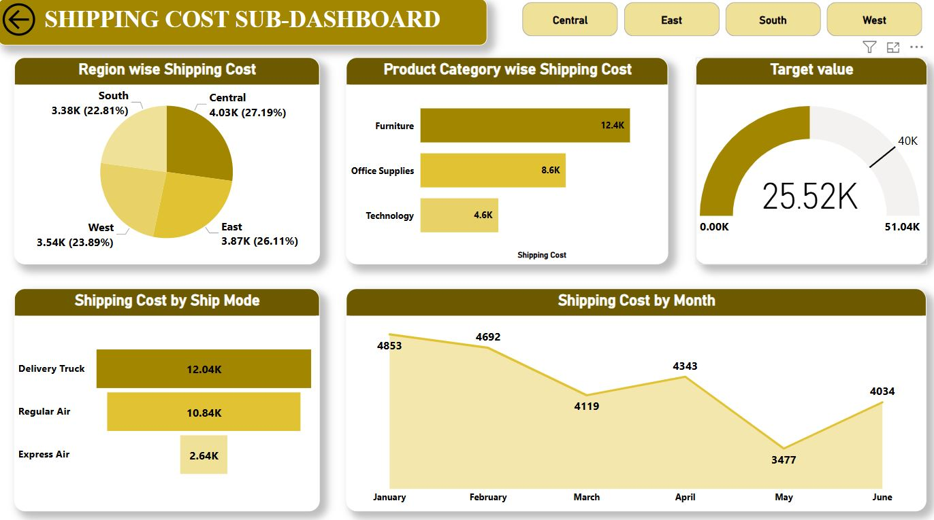
SHIPPING COST SUB-DASHBOARD
This Shipping Cost Sub-Dashboard provides a comprehensive overview of key shipping cost metrics using various visualizations.
Region-wise Shipping Cost: The Central region has the highest shipping cost (4.03K), followed by East (3.87K), West (3.54K), and South (3.38K).
Product Category-wise Shipping Cost: Furniture (12.4K) incurs the highest shipping cost, followed by Office Supplies (8.6K) and Technology (4.6K).
Target Value: The current shipping cost is 25.52K, with a target of 40K and a maximum threshold of 51.04K, helping track progress toward shipping cost goals.
Shipping Cost by Ship Mode: Delivery Truck (12.04K) has the highest shipping cost, followed by Regular Air (10.84K) and Express Air (2.64K), suggesting cost variations across different shipping methods.
Shipping Cost by Month: The cost fluctuates over six months, starting at 4,853 in January, peaking in February (4,692), and dropping in May (3,477) before rising again in June (4,034).

Slide 8
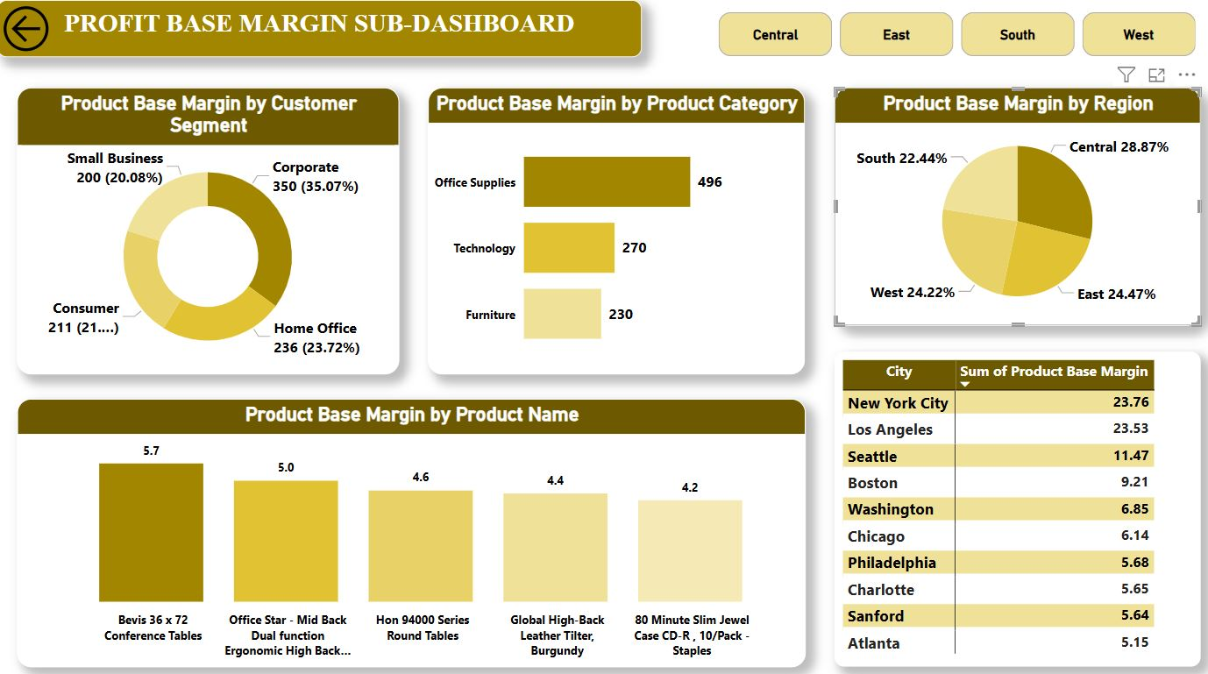
PROFIT BASE MARGIN SUB-DASHBOARD
This Profit Base Margin Sub-Dashboard provides a comprehensive overview of key profitability metrics using various visualizations.
Product Base Margin by Customer Segment: The Corporate segment has the highest profit base margin (35.07%), followed by Home Office (23.72%), Consumer (21%), and Small Business (20.08%).
Product Base Margin by Product Category: Office Supplies (496) contributes the most to profit margins, followed by Technology (270) and Furniture (230).
Product Base Margin by Region: The Central region has the highest profit margin (28.87%), followed by East (24.47%), West (24.22%), and South (22.44).
Product Base Margin by Product Name: The top-performing products include Bevis 36 x 72 Conference Tables (5.7), Office Star Mid-Back Ergonomic Chair (5.0), and Hon 94000 Series Round Tables (4.6).
City-wise Product Base Margin: New York City (23.76) and Los Angeles (23.53) have the highest product base margins, followed by Seattle (11.47) and Boston (9.21).

Slide 9
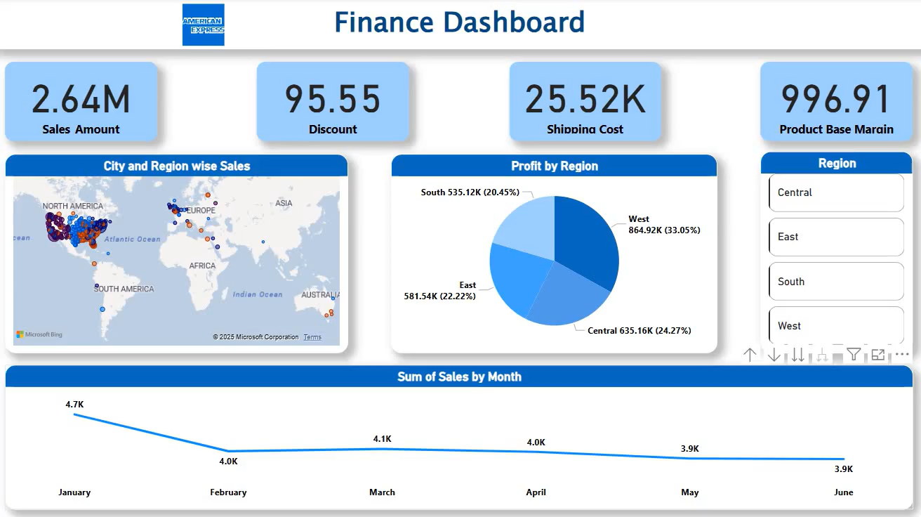
Finance Dashboard Full Video

Slide 10
Conclusion
The finance dashboard provides a comprehensive overview of key business metrics, including sales, discounts, shipping costs, and profit margins. Sales are strongest in the West, with technology leading in revenue generation. Discounts are highest in office supplies, and shipping costs are primarily driven by furniture deliveries. The central region incurs the highest shipping costs, while corporate clients contribute the most to profit margins. New York and Los Angeles lead in profitability. Overall, efficient cost management and strategic product focus can enhance profitability and drive growth.

Slide 11
Thank you
Ayonika Dutta

